Slide 1

Department of BES-II
BASIC ELECTRICAL AND ELECTRONIC CIRCUITS
COURSE CODE : 23EC1203
Topic:
Transistor as a switch
Session – No. 10a

Slide 2


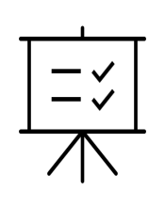

AIM OF THE SESSION
To understand the principles, characteristics, and applications of Zener diodes.
INSTRUCTIONAL OBJECTIVES
This Session is designed to:
1. Identify the operating principles of a Zener diode.
2. Differentiate between forward and reverse biasing in a Zener diode.
3. Explain the applications and usage of Zener diodes in electronic circuits.
LEARNING OUTCOMES
At the end of this session, you should be able to:
1. Describe the breakdown behavior and voltage regulation of a Zener diode.
2. Demonstrate the ability to analyze circuits incorporating Zener diodes for specific voltage regulation purposes.
3. Apply knowledge of Zener diodes to troubleshoot and design circuits involving voltage stabilization and regulation.

Slide 3

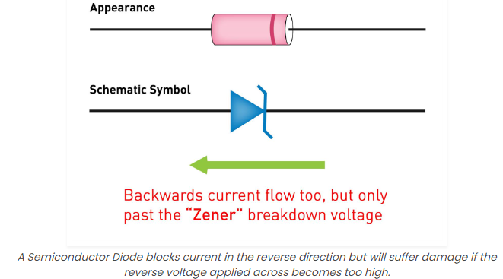
What is a Zener Diode?
Definition
A Zener diode is a semiconductor device that allows current to flow in the reverse direction when a certain voltage is applied, effectively acting as a voltage regulator.
Operation
When voltage across a Zener diode exceeds its breakdown voltage, the diode begins to conduct and regulate the voltage, maintaining a constant level.

Slide 4
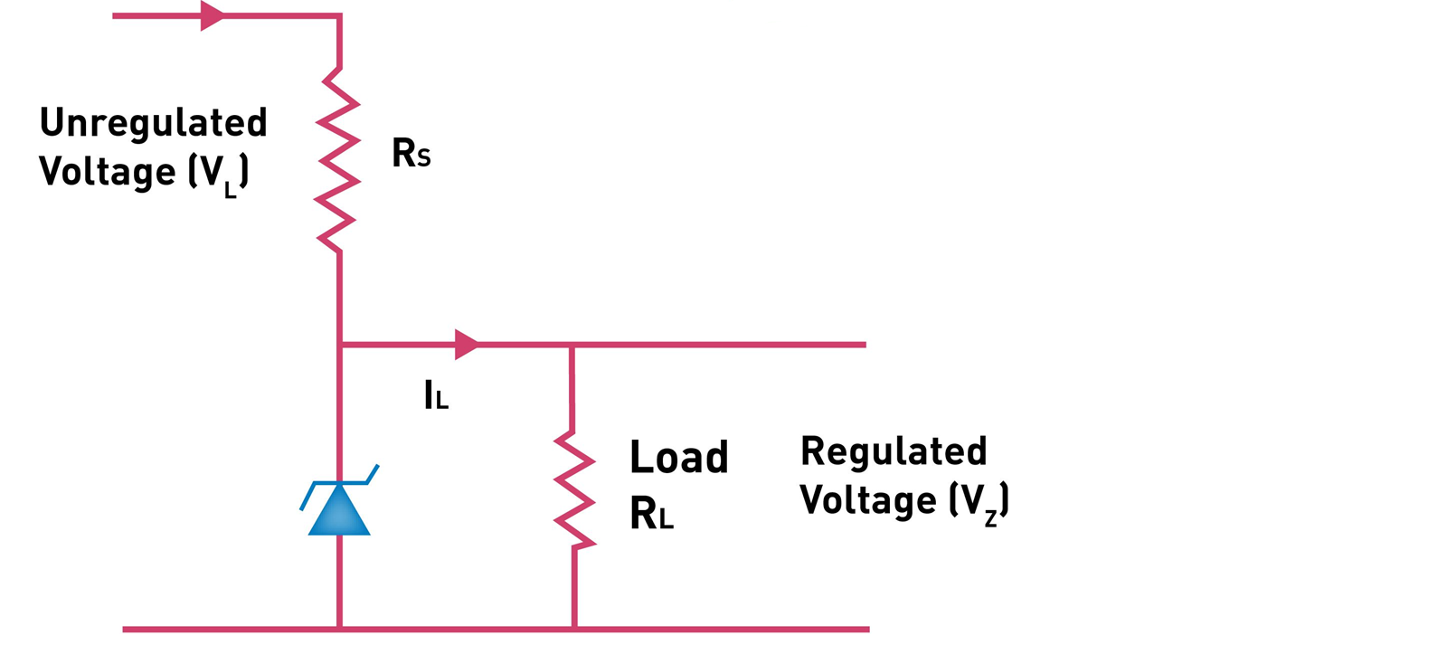
Zener Diode as Voltage Regulator

Slide 5

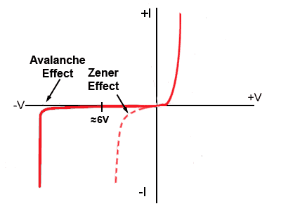
Zener Diode as a Voltage Regulator
1
Voltage Regulation
2
Working Principle
Zener diodes regulate voltage by maintaining a constant voltage across themselves even when the input voltage varies, ensuring a stable output.
As the input voltage rises beyond the Zener diode's breakdown voltage, it starts conducting, diverting the excess current and preventing voltage spikes.
3
Stability and Reliability
Due to their precise voltage regulation, Zener diodes provide stable and reliable power supply for various electronic circuits and systems.

Slide 6
Benefits of Using Zener Diodes as Voltage Regulators
Stability
Reliability
Low Cost and Simplicity
Zener diodes offer consistent voltage regulation, minimizing fluctuations in the output voltage despite changes in the input voltage or load.
With their rugged construction, Zener diodes are resistant to temperature variations and able to withstand high currents, ensuring long-term reliability.
Zener diodes are readily available and cost-effective compared to other voltage regulation solutions, making them popular in various applications.

Slide 7
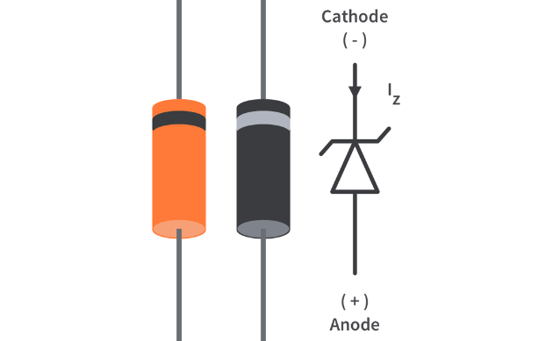
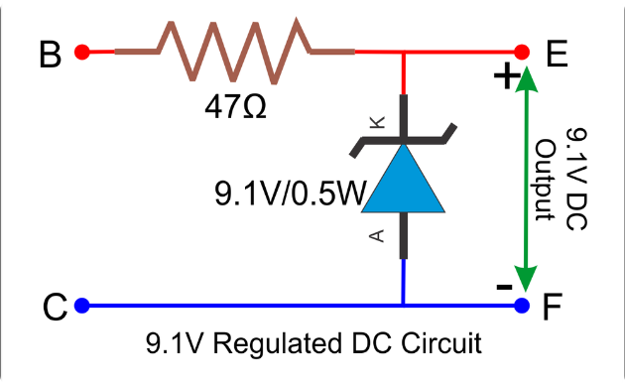
Applications of Zener Diode Voltage Regulators
Electronic Circuits and Systems
Power Supplies and Battery Chargers
Zener diodes find wide applications in voltage regulation for microcontrollers, sensors, amplifiers, and other electronic components.
They are commonly used in power supplies and battery charging circuits to maintain stable voltage levels and protect sensitive components.

Slide 8

SELF-ASSESSMENT QUESTIONS
1. What is the primary function of a Zener diode? ©
Amplification
B) Rectification
C) Voltage regulation
D) Current regulation
Zener breakdown occurs when: (B)
Increase voltage
Decrease voltage
Regulate voltage
Stabilize current

Slide 9
SELF-ASSESSMENT QUESTIONS
3. Zener breakdown occurs when: (B)
Forward biased
Reverse biased
Used in amplification circuits
Connected in series
4. Zener diodes are often used in circuits to: ©
Increase voltage
Decrease voltage
Regulate voltage
Stabilize current

Slide 10
TERMINAL QUESTIONS
1. Explain the operating principle of a Zener diode and highlight its differences from a regular diode.
2. Discuss two practical applications of Zener diodes in electronic circuits. Explain how the Zener diode functions in each application.
3. Compare and contrast Zener diodes with avalanche diodes, highlighting their similarities and differences in operation and applications.

Slide 11
THANK YOU
Team – BASIC ELECTRICAL & ELECTRONIC CIRCUIT

